Slide 1
Neural Network Assisted Temporal Reduction for Transmission Expansion Planning

Slide 2
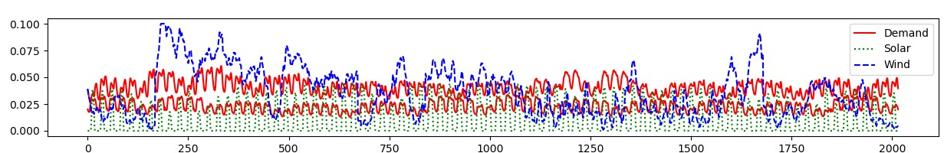
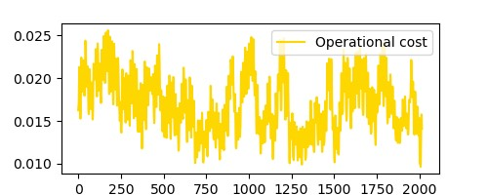
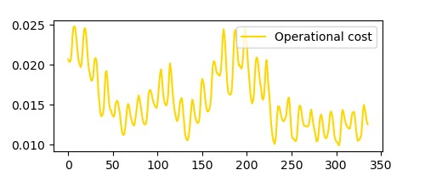
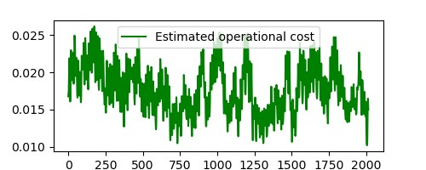
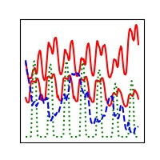
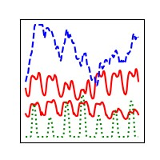
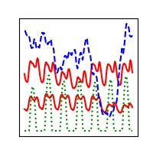
Relaxed ESOM
Relaxed ESOM
Features
Clustering
Method
Clustering
Method
Training
Evaluation
Clustering
Method
Representative Time Series
ML algorithm
NN-assisted ex-post clustering
No temporal reduction
Input-based clustering
Ex-post clustering
ESOM
ESOM
ESOM
ESOM

Slide 3
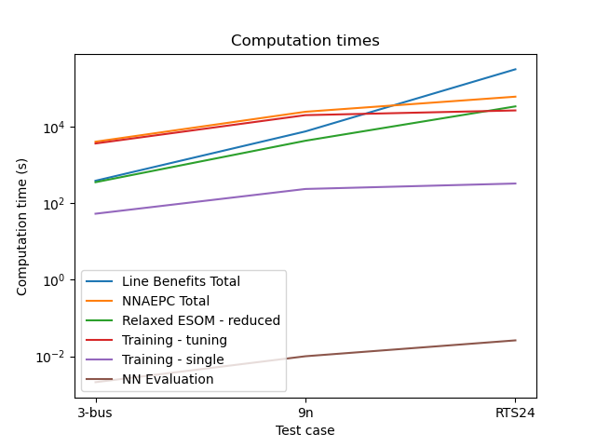
Comparison: computation time

Slide 4
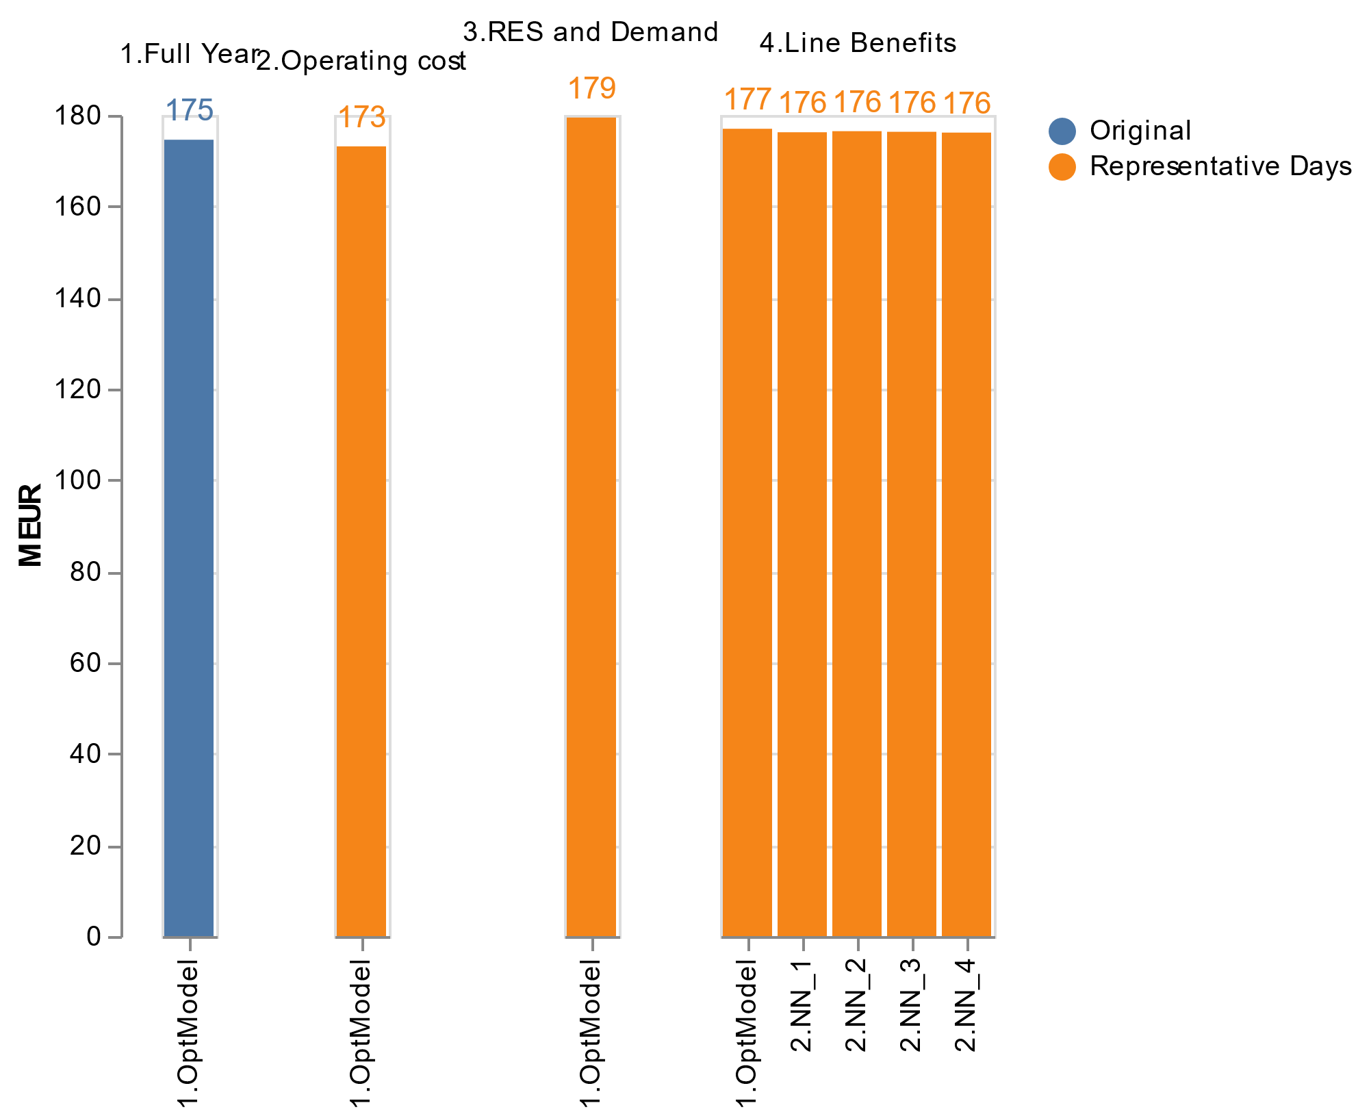
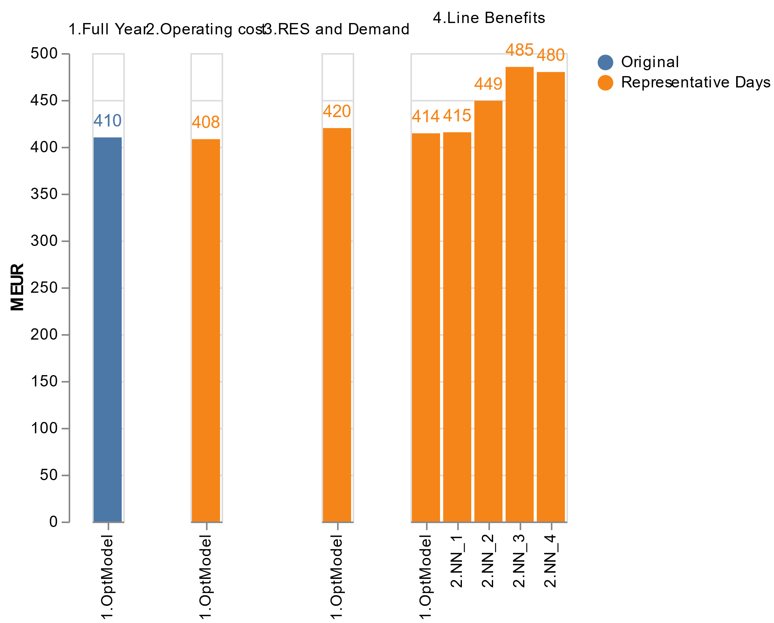
Comparison: total system cost
3-bus
9n

